Slide 1
Resolution of Tactile Stimuli
Tim Peko, Moritz Kieselbach

Slide 2
Table of contents
01
02
03
04
05
Mechano-
receptors
Resolving-
Power
Experimental
Setup
Analysis
Results

Slide 3
01
Mechanoreceptors

Slide 4
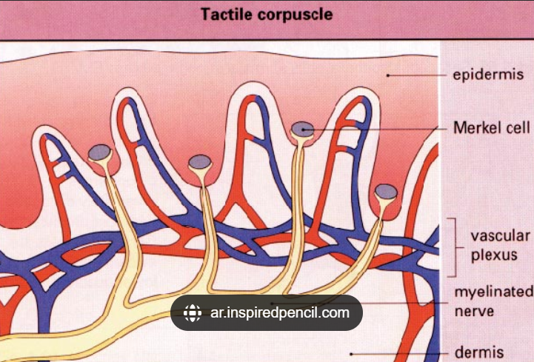
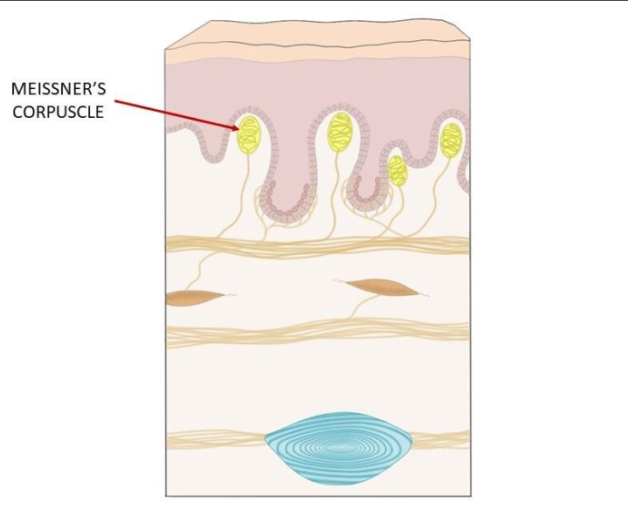
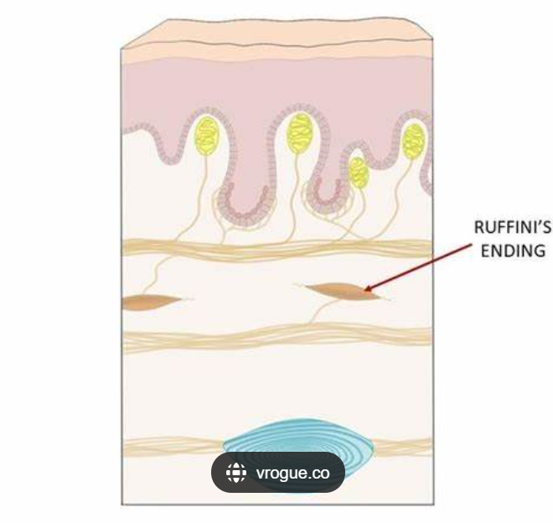
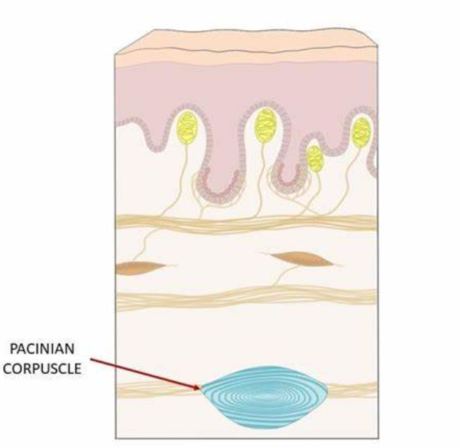
Background: Mechanoreceptors & Tactile Sensitivity
Meissner’s corpuscles
Merkel cells
Ruffini endings
Pacinian corpuscles

Slide 5
02
Resolving-Power

Slide 6
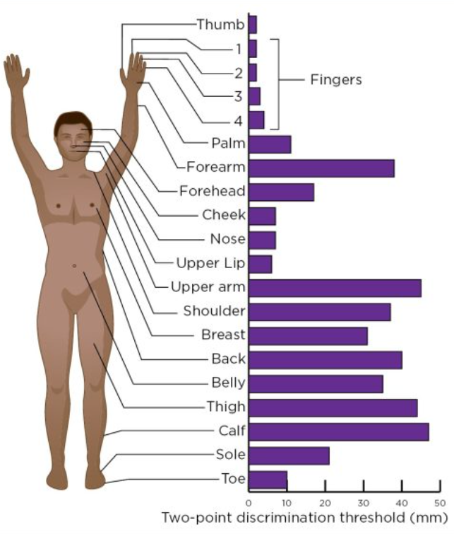
Tactile Resolving Power

Slide 7
03
Experimental Setup

Slide 8
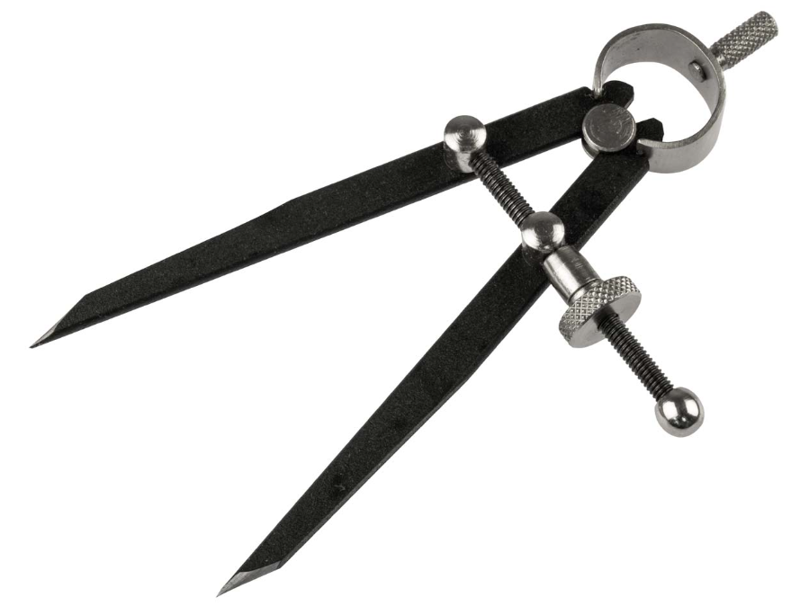

Materials
Two-point divider
Ruler or scale
optional
Alcohol swabs
Blindfold
Notebook & pen
2 People

Slide 9
Two-Point Discrimination Test
00. Sanitize
Equipment
01. Subject Preparation
02. Initial Positioning
03. Stimulus Delivery
04. Adjust Distance
05. Threshold Determination
06. Repeat for All Regions

Slide 10
04
Analysis
What data did we use for our analysis?

Slide 11
Datasources
 | Description | # Males/Females
Our class | 2025 MBI2024 | 5/5 = 10
All years | 2015-2025 | 175/186 = 361

Slide 12
Approach
t-Test per Body Region
Descriptive Statistics on our Dataset
Descriptive
Gender Comparison
Body Region Comparison
Interpretation
Interpret and Discuss the Results
t-Test

Slide 13
05
Results
The observations we made, mainly from our class

Slide 14
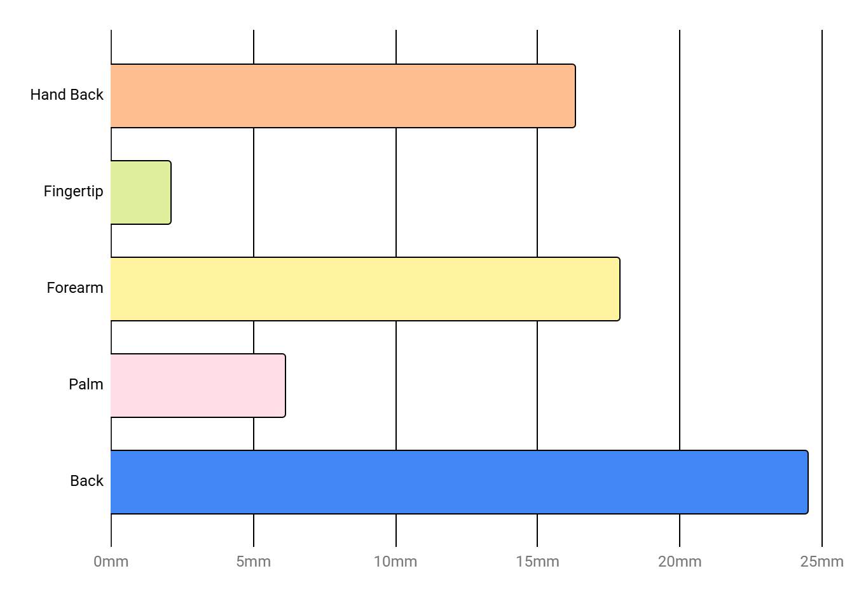
Mean of different regions
Hand Back
Fingertip
Forearm
Palm
Back

Slide 15
Descriptive Statistics
 | Hand Back | Fingertip | Forearm | Palm | Back
# Participants | 10 | 10 | 10 | 10 | 2
Mean | 16.30 ± 4.74 mm | 2.10 ± 1.10 mm | 17.85 ± 9.06 mm | 6.11 ± 3.46 mm | 24.50 ± 2.12 mm
Median | 16.50 mm | 2.00 mm | 18.50 mm | 6.00 mm | 24.50 mm
Range | 10.00 - 23.00 mm | 1.00 - 4.00 mm | 6.00 - 37.00 mm | 0.00 - 11.50 mm | 23.00 - 26.00 mm

Slide 16
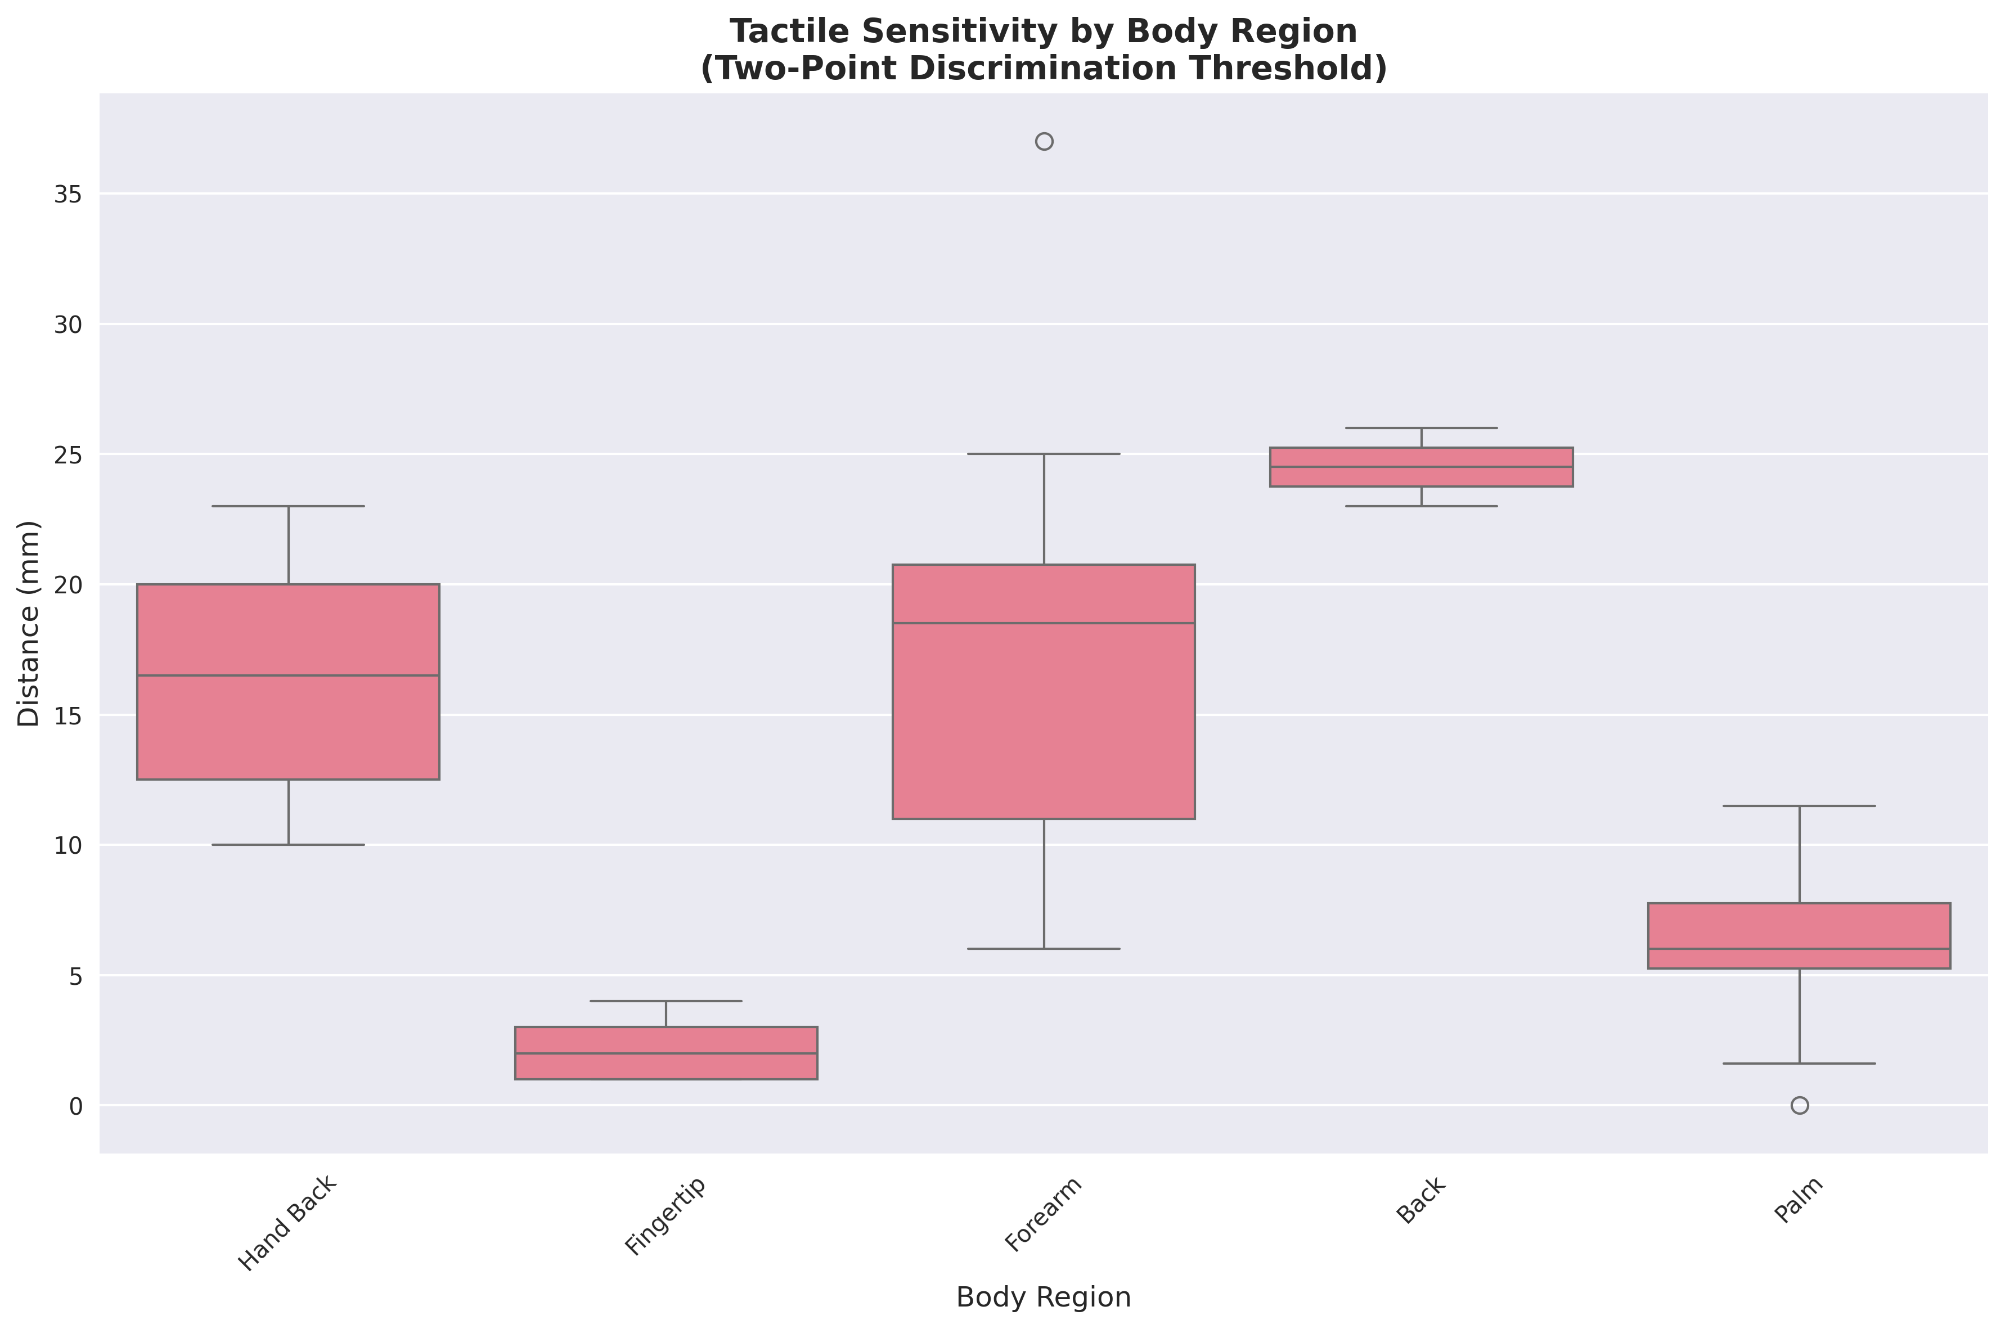
Boxplot of Body Regions

Slide 17
t-Test Results
p-value = 63.73%
Forearm
Hand Back
Insignificant
Differences
Forearm
Back
p-value = 34.26%

Slide 18
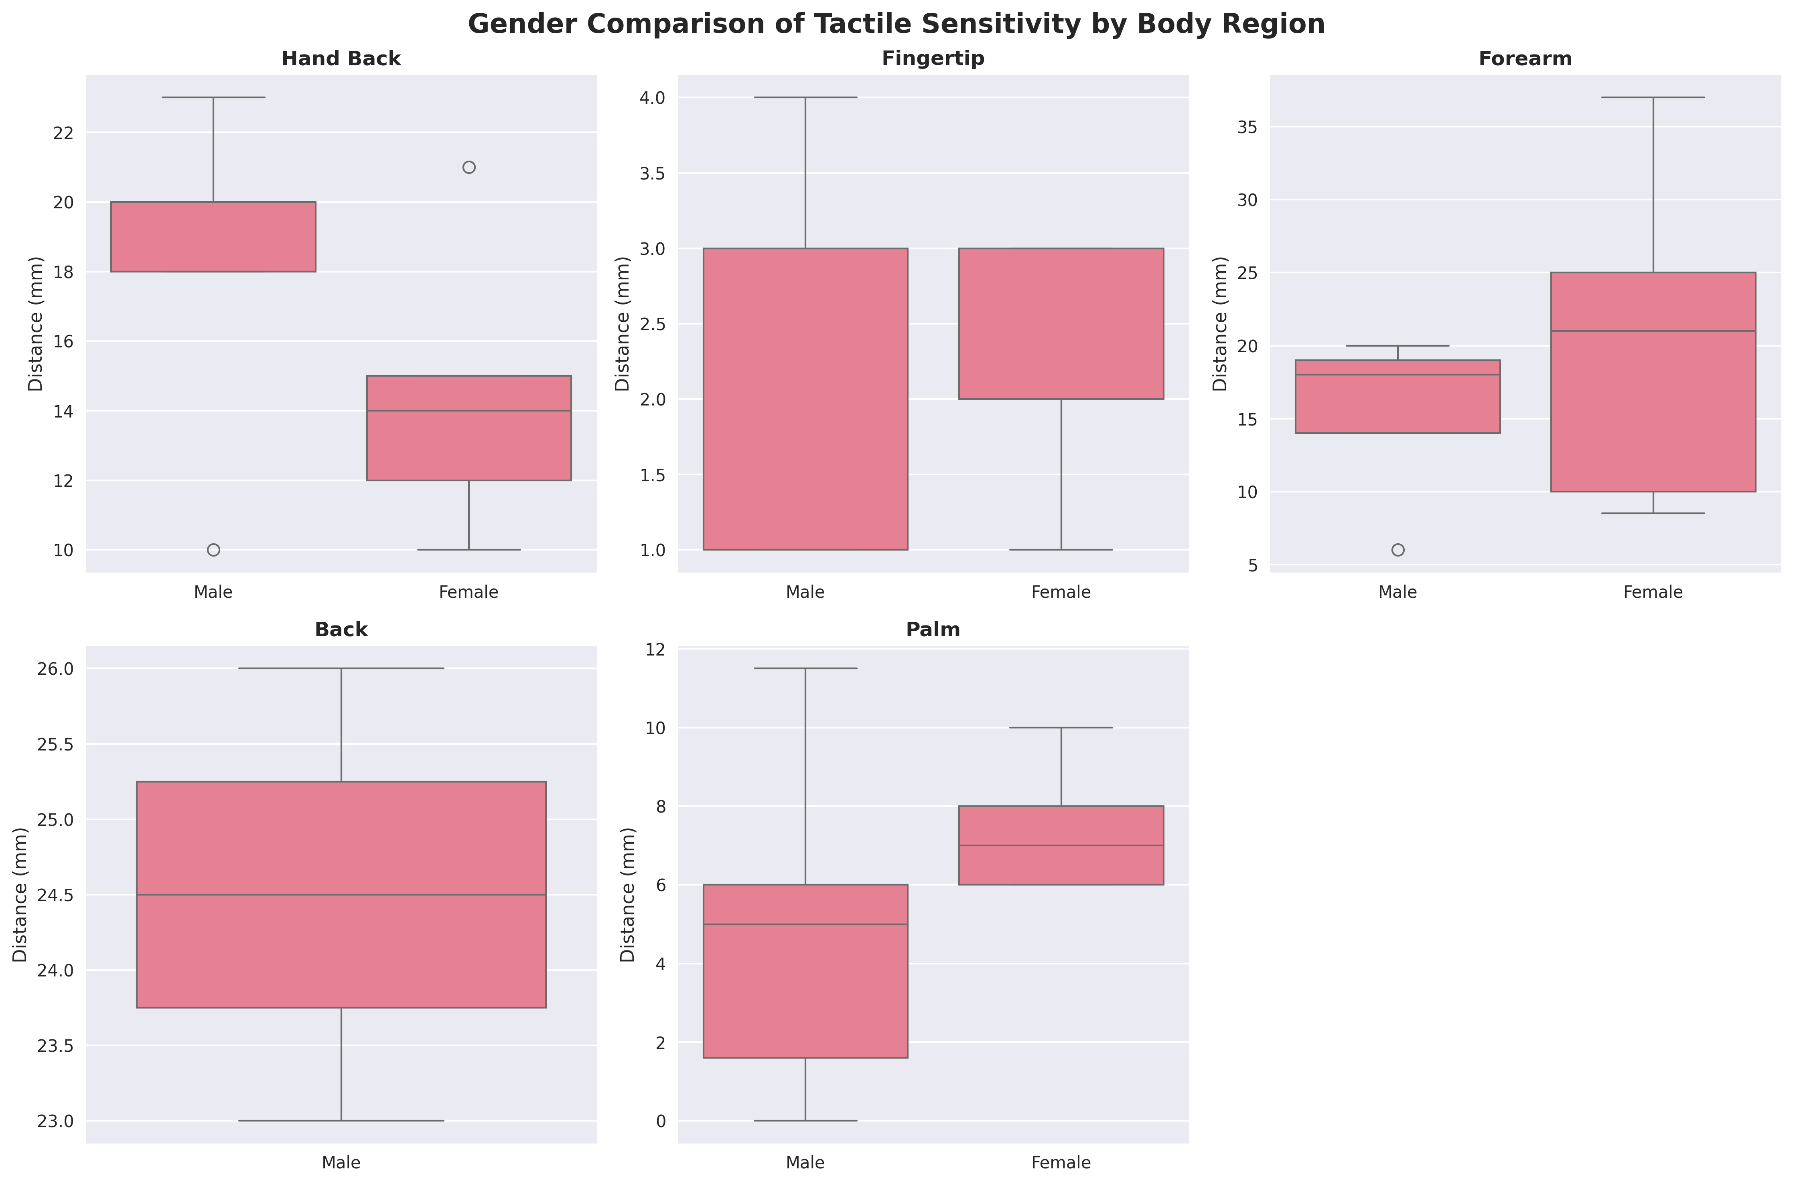
Gender comparison

Slide 19
Interpretation
Most sensitive
Least sensitive
Fingertip (2.10 mm)
Back (24.50 mm)
Consistent
Reflects
With known distribution of mechanoreceptors
Importance for
tactile discrimination
Notes:
5. INTERPRETATION
--------------------
Most sensitive region: Fingertip (2.10 mm)
Least sensitive region: Back (24.50 mm)
DISCUSSION:
The results show varying tactile sensitivity across different body regions.
This variation is consistent with the known distribution of mechanoreceptors:
- Fingertips typically have the highest density of receptors (smallest threshold)
- Back and forearm typically have lower receptor density (larger threshold)
- The results reflect the functional importance of different body parts
for tactile discrimination tasks.

Slide 20
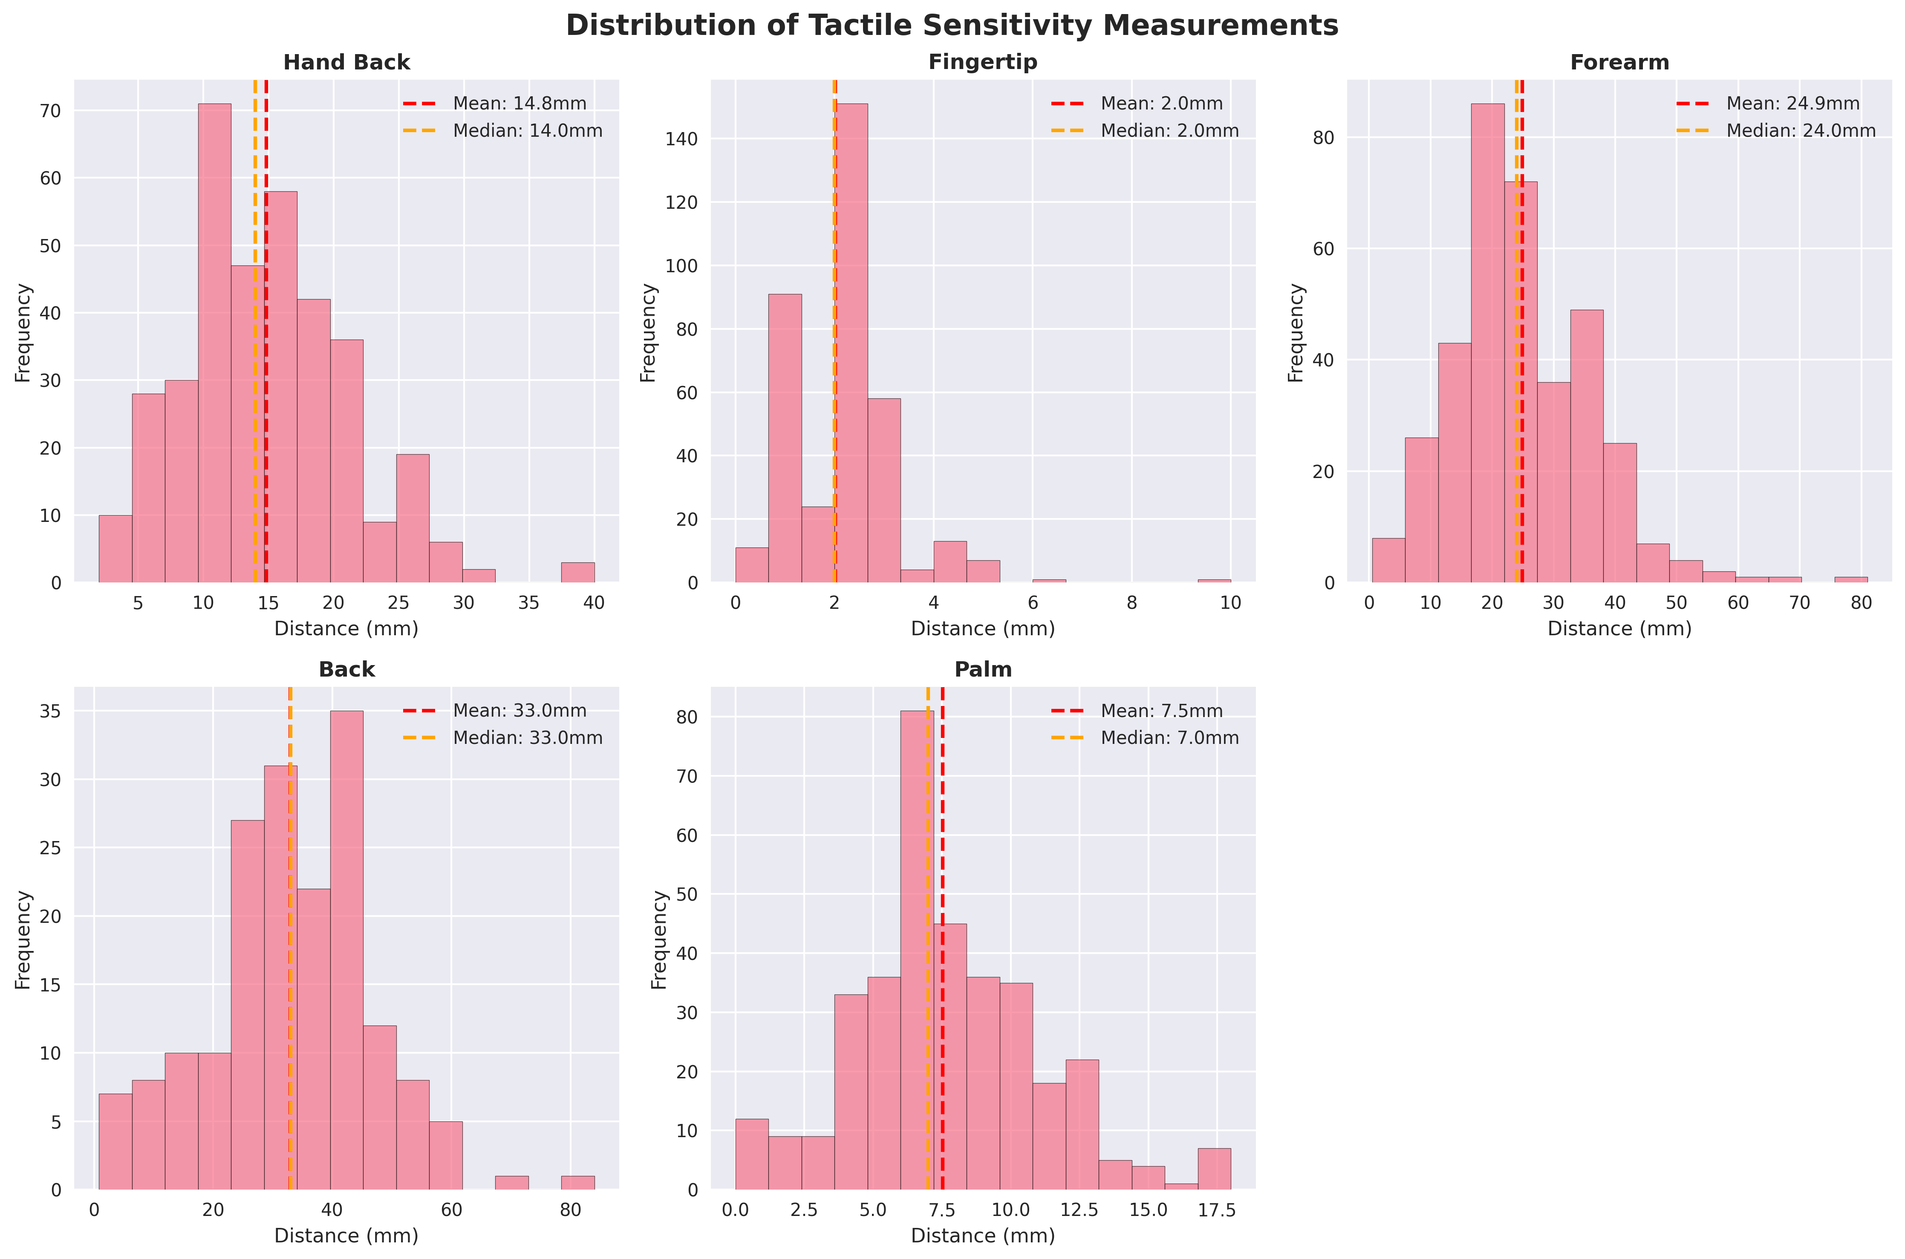
Distribution for all years

Slide 21
Comparison with all years
t-Test showed signficant difference between ALL regions
Similarities:
No relevant difference between genders
Order of increasingly sensitive regions
Most sensitive region: Fingertip
Least sensitive region: Back

Slide 22
Thanks!
Do you have any questions?

